Slide 1
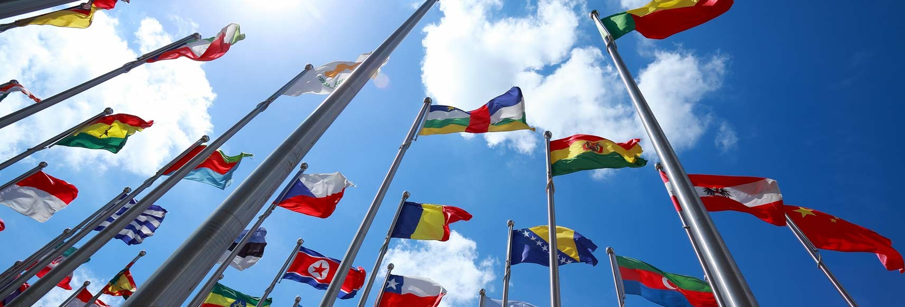
INTERNATIONAL DISPUTE RESOLUTION

Slide 2
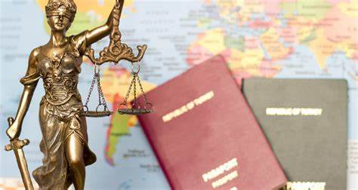
Executive Summary
The report is going to discuss the dispute between Honduras and Belize.
The dispute has been an emerging concern as it violates the American Treaty.
The method for solving the dispute taken is the conciliation method.
Notes:
The report is going to shed light on the dispute between Honduras and Belize. The matter is concerning as it violates the American Treaty.

Slide 3
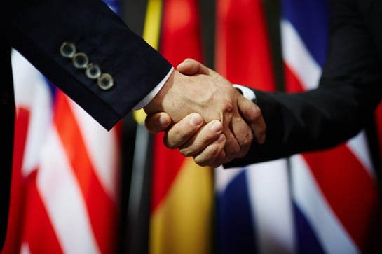
Introduction
An international dispute is a disagreement between two states or territories.
There are various aspects of disagreement such as political and legal disagreement.
In this study, Sovereignty over the Sapodilla Cayes case is chosen.
Notes:
An international dispute can be defined as a disagreement between two states or territories. An international dispute mainly occurs when there is a showcase of wrong attitudes from any country. In order to complete the report, The dispute between Honduras and Belize is chosen. This case is widely known as Sovereignty over the Sapodilla Cayes.

Slide 4
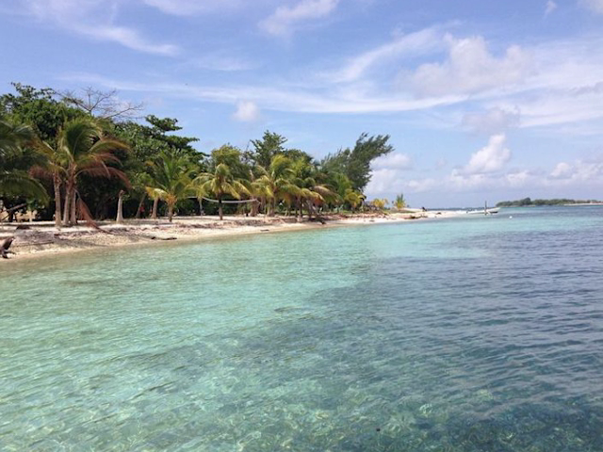
Background of the situation
The caving group of the Gulf of Honduras is famously known as Sapodilla Cayes.
The Cayes are in the territory of Belize.
This area is a part of the ‘Independent State of Belize’ (history.state.gov, 2019).
Notes:
It has been found that in the Gulf of Honduras, there are numerous caves, famously known as Sapodilla Cayes. These Cayes are an integral part of the ‘independent State of Belize’. Since 1981, this whole area was accounted for the part of Belize.

Slide 5
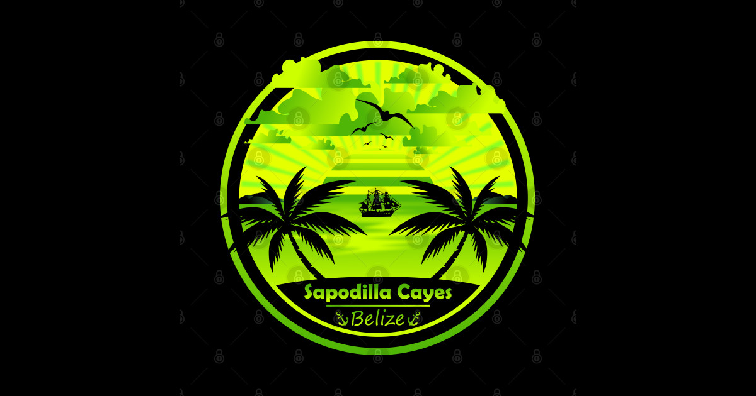
The issue
The main issue that arose related to this area is the land ownership.
The government of Honduras claimed that the area has been used as military spots.
The dispute occurred when the government of Honduras tried to claim the area for the acknowledgement of the sovereignty of the United Kingdom.
Notes:
The dispute between the country, Honduras and Belize arose for the claim of land ownership of the Sapodilla Cayes. According to the government of Honduras, the area of Sapodilla Cayes is being used as military spots. Moreover, the governmnet of Honduras tried to claim the area to be acknowledged by the sovereignty of the United Kingdom.

Slide 6
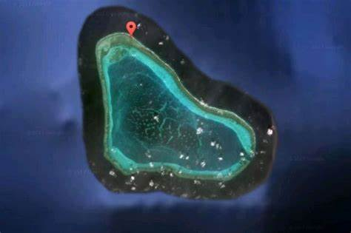
The issue Contd….
The dispute between the two governments occurred as Honduras tried to claim ownership using international law.
The request has been claimed by the government of Honduras using the “American Treaty on Pacific Settlement’’.
The government of Belize is willing to use the ‘Treaty of Bogata’.
Notes:
It has been found that the dispute related to the ownership of Sapodilla Cayes occurred when the government of Honduras tried to claim the area using the international law “American Treaty on Pacific Settlement’. The reason behind the claim was the area has been used by the government of Belize as military spots. However, the governmnet of Belize will use the ‘Treaty of Bogata’ to counter the claim of Honduras.

Slide 7

The dispute settlement method
The dispute will be settled by the conciliation method.
The dispute matter has been taken to the International Court of Justice By the Independent State of Belize.
According to the government of Belize, the area rightfully belongs to them.
However, Honduras claims that the state of Belize is just sovereign over the Sapodilla Cayes.
Notes:
In order to resolve the dispute between the country, the case has been taken to the International Court of Justice by the government of Belize. According to them, the ownership of that particular area belongs to them. However, the government of Honduras counters that the state of Belzie’s claim has no base in international law.

Slide 8

Possible other options
The other option for resolving the issue can be negotiation.
In addition to it, mutual agreement can also be an effective way to resolve international disputes.
Another best option is mediation.
Article 25 of the UK Constitution allows conflicting parties to create requests in terms of the creation of the “Conciliation Commission” (ippr.org, 2019).
Notes:
Negotiation can be an effective way to resolve the dispute between Honduras and Belize. Furthermore, discussions between government officials and mutual agreement can also be an effective way to resolve the issue of Sovereignty over the Sapodilla Cayes. In addition to it, mediation can be the best option for resolving conflicts as the presence of a neutral third party can help both nations to come to a conclusion. In this aspect, article 25 of the UK Constitution comes handy as it helps the parties involved in the conflict to request for a Conciliation Commission for resolving the issue.

Slide 9

Influence on the chosen method
Article 31 of the ‘Pact of Bogota States that the Cayes are an integral part of the independent state of Belize (icj-cij.org, 2019).
Article 54 of the pact also has a great influence on this dispute (state.gov, 1948)
Article 6 of the treaty also highlights the importance of possible arrangements for resolving international disputes (state.gov, 1948).
In addition to it, the Commission of international law established in 1947 also played a significant role (Freitas et al., 2022).
Notes:
The government of Belize has taken the dispute to the International Court of Justice. In addition to it, the government is also willing to use Article 31 of the Bogata Pact as well as Article 54. In addition to it, the dispute between both countries will be resolved by the Conciliation Commission in court.

Slide 10
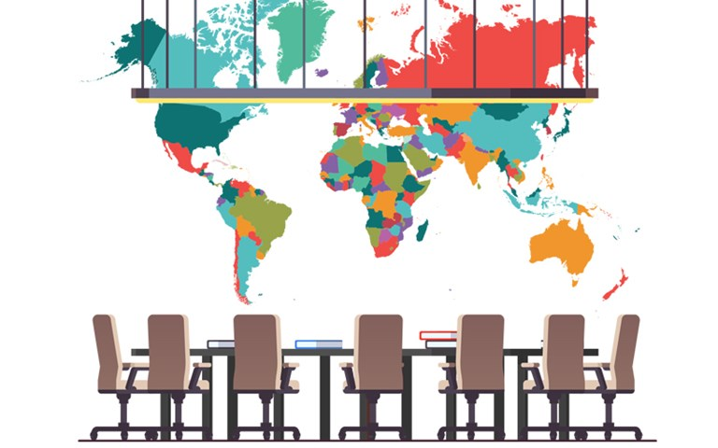
Critical evaluation of the chosen method
The advantage of using the conciliation method is the flexible nature of the method.
This method also can create an opportunity for both countries to develop a “non-binding settlement” proposal.
In addition to it, the conciliation commission can create the legal framework for resolving the issue.
Notes:
The creation of a neutral third party i.e. conciliation commission will give both countries an opportunity to come to a non-binding settlement. It can also be found that both countries are claiming their ownership using various international laws and treaties. The commission can be helpful in this aspect by creating a legal framework for resolving the issue.

Slide 11

Conclusion
The dispute between Honduras and Belize has been chosen for completing the study.
The case has been taken to the International Court of Justice by the government of Belize.
In order to resolve the dispute between Honduras and Belize, the conciliation method is more appropriate.
Notes:
It has been found that a dispute arose between Honduras and Belize regarding the Sapodilla Cayes. For resolving the dispute, the conciliation method is ideal. The conciliation method can be appropriate for solving the issue as it is flexible in nature. Moreover, various other possible methods for solving the dispute has also been identified in the report.

Slide 12
References
icj-cij.org (2019) International Court of Justice. Available at: https://www.icj-cij.org/public/files/case-related/185/185-20221117-PRE-01-00-EN.pdf (Accessed: April 29, 2023).
state.gov (1948) American Treaty on Pacific Settlement (Pact of Bogota), U.S. Department of State. U.S. Department of State. Available at: https://2009-2017.state.gov/p/wha/rls/70580.htm (Accessed: April 29, 2023).
Freitas, G.D.N.B., Lima, L.C. and Soares, R.V.C., 2022. Left Out in The Cold? Judicial Settlement of Disputes During The Cold War. Cadernos do Programa de Pós-Graduação em Direito–PPGDir./UFRGS, 17, pp.47-65.
ippr.org (2019) The constitution of the United Kingdom. Available at: https://www.ippr.org/files/images/media/files/publication/2014/01/the-constitution-of-the-united-kingdom_1991-2014_1420.pdf (Accessed: April 29, 2023).
history.state.gov (2019) U.S. Department of State. U.S. Department of State. Available at: https://history.state.gov/countries/belize (Accessed: April 29, 2023).

Slide 13


